Slide 1
ZILA VIKAS MANCH(ZIVIMA)​
​
“I.T. + I.T. = I.T.”
Indian talent + Information technology = India tomorrow
– Narendra Modi​
​

Slide 2

A Portal to Upload the District Specific Problems, Projects etc.

Slide 3
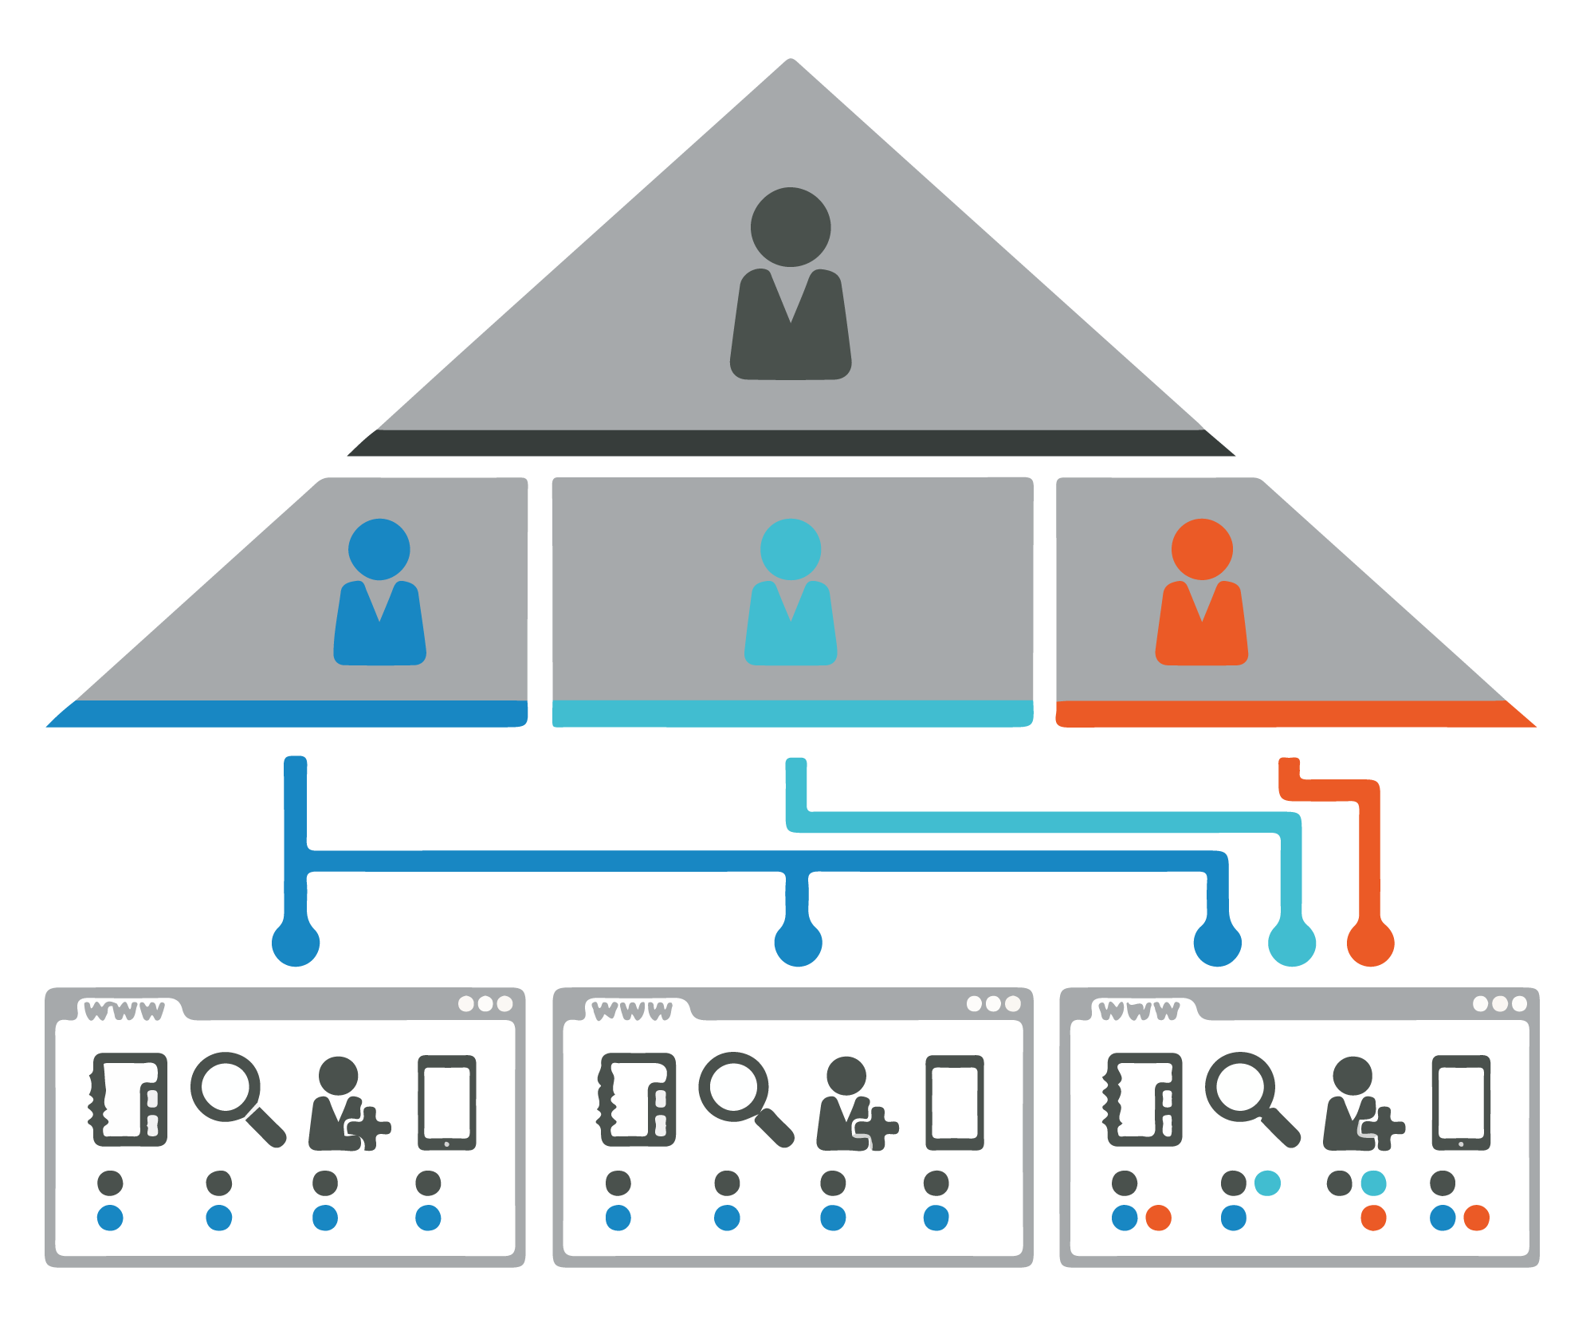
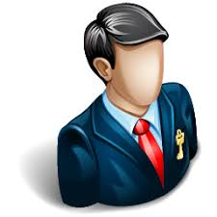

Problem Statements can be added by State Admin, District Collector, and District Users who are registered.
State Admin
Can view Problems
District Collector
Super Admin

Slide 4
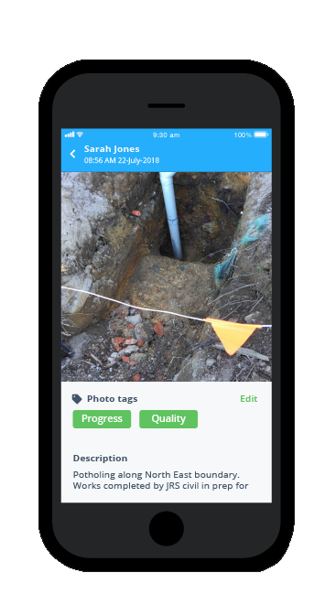

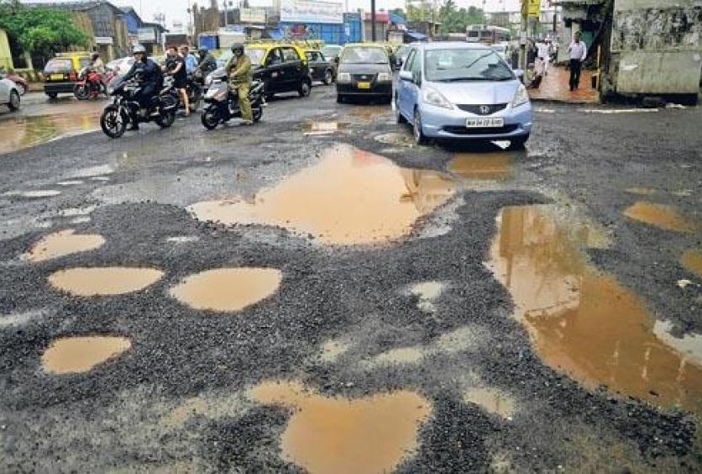
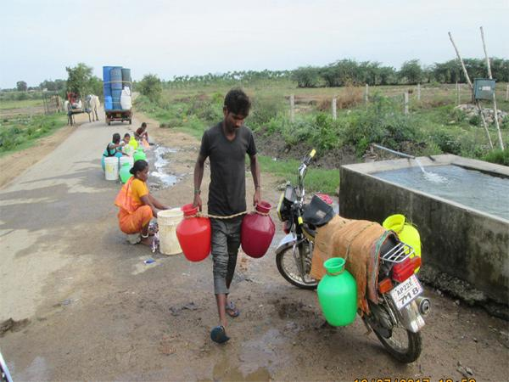
The People of the district will be allowed to upload request and complaints.
Geo Tagging

Slide 5


Voice to text for People of the District.

Slide 6

Accessible to all Institutes so that students can select the problems to which they wish to give solution.

Slide 7




Also students can use that project as their final year project.
Civil Engineering
Computer Engineering
Electrical Engineering

Slide 8

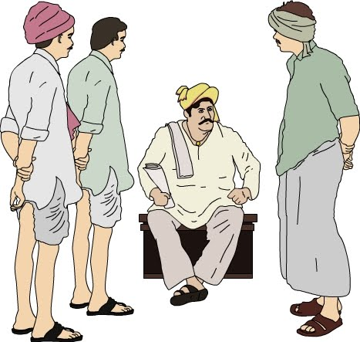
Polling would be conducted for the people of the district to vote in favour of any one solution with majority votes would be considered.

Slide 9
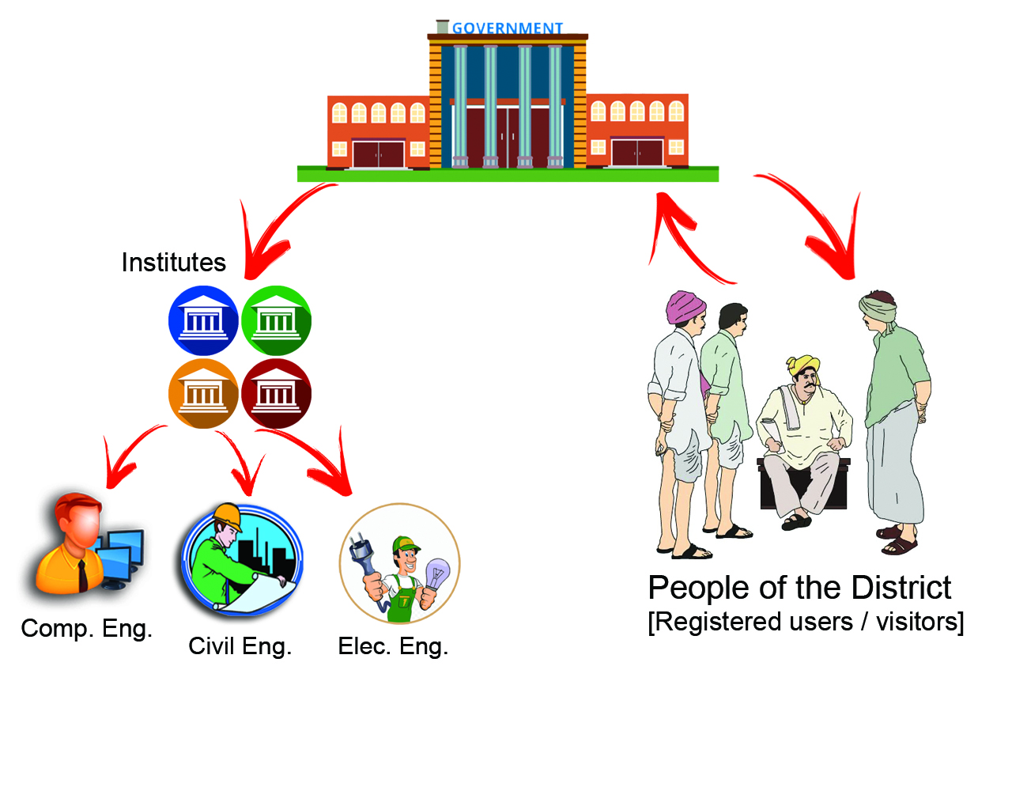
Project Flow

Slide 10
Thank You!

